Slide 1
First Cypress Code

Slide 2
Chapter 2: First Cypress Code.
Test Senario Vs Test Case
Cypress Test Code structure
Review nameless and arrow function
Describe block
it block
.skip
.only
cy.log()
cy.url()
Testp Steps

Slide 3
Test Scenario Vs Test Case?
A Test Scenario is defined as any functionality that can be tested. It is a collective set of test cases.
In one test scenario will have many test case.
A test Case is a set of actions executed to verify particular features or functionality,
Test Case is mostly derived from test scenarios.
Test Scenario : Check the Login Functionality Gmail.
Test Case:-
Check system behavior when valid email id and password is entered.
Check system behavior when invalid email id and valid password is entered.
Check system behavior when valid email id and invalid password is entered.
Check system behavior when invalid email id and invalid password is entered.

Slide 4
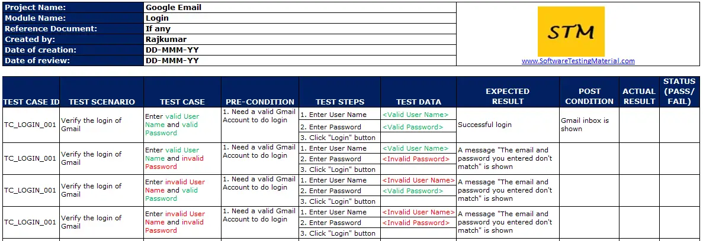
con’t

Slide 5
con’t
Test Terminology
Scenario Describtion (name):
Test Case Description (name):
Test case Steps:
Test Data:
Expected Result:
Actual Result:

Slide 6
Cypress Test Code structure
describe('Check the Login Functionality Gmail', () => {
it(‘Check system behavior when valid email id and password is entered’ , () => {
Test Steps:
//visity gmail website open
// enter email => test data
// enter password => test data
// click login button
// Assertion
// Comper Expected Result vs Actual Result
})
})

Slide 7
Describe block
This keyword is used to create a test suite (Test scenario) or a group of related test cases.
It takes two arguments: a descriptive text that explains what is being tested(Test scenario name) and a callback function that contains the test cases that belong to this suite.
The purpose of using “describe” block is to organize the tests case and provide a clear structure to the testing code.
describe(‘checking login funct of gmail’, ()=> {
it()
it()
it()
}
)

Slide 8
it block
This keyword is used to define a single test case.
It also takes two arguments: the name of test case and a callback function that contains the actual test logic (test steps).
The purpose of using `it` is to clearly indicate what specific functionality is being tested.
it(‘test case name’, ()=>{
Test Steps.
}
)

Slide 9
Review nameless and arrow function
Nameless functions, also known as anonymous functions,
are functions that do not have a specified name.
Syntax.
function (){
// body
}
Arrow functions are a shorthand alternative to name less function.
Syntax.
() => {
// body
}

Slide 10
Con’t
In a test file, we can have multiple “describe” blocks, each containing multiple “it” blocks.
The “describe” blocks help in organizing the tests into logical groups, while the “it” blocks define the individual test cases within each group.

Slide 11
skip
The skip function in Cypress is used to exclude a specific test case (it block) or test suite(descibe block) from being executed.
When you use skip on a test (it block) or test suite (describe block), Cypress will completely skip running that particular test case or suite.
This can be useful when you want to temporarily exclude a test from execution,

Slide 12
only
The only function in Cypress is used to exclusively run a specific test case or test suite.
When you use only on a test case (it block) or test suite (describe block), Cypress will execute only the tests that have the only flag, ignoring all other tests in the suite.
This is helpful when you want to focus on a specific set of tests during development or debugging.

Slide 13
cy.log()
The cy.log() command in Cypress is used to log messages to the Cypress Command Log during test execution.
It allows you to output custom messages or values for debugging or informational purposes.

Slide 14
Testp Steps
Example write automation test case code by using cypress for Verify search functionality for google home page.
Expected Result:- The search results page should be displayed with relevant results related to the entered query.
Test steps:-
1.Open the Google homepage
2.Find search box
3.Enter a search query (text) in the search box
4.Find Googel search button
5.Press click on button.
6. assert (Compare) actual results with expected results

